Slide 1
Security of IoT in Automobile
Hongzhi Fu

Slide 2
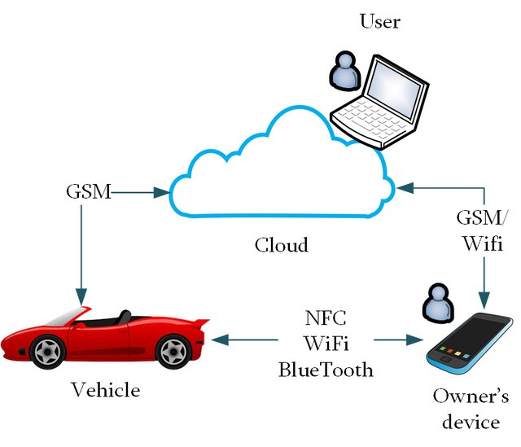
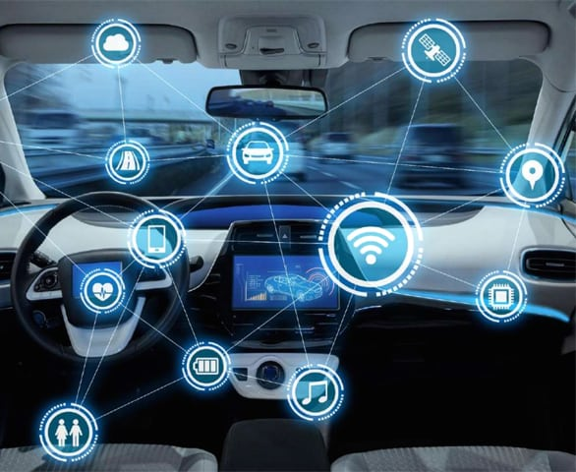
What they can do?

Slide 3
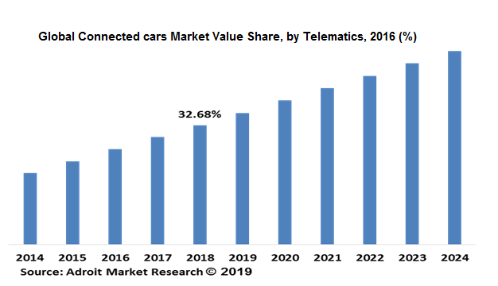
Connected Car is popular

Slide 4
Major Security Threats
1. Car Theft (unauthorized driver starts the car)
2. Cyber Hacker (tamper key information via Internet)
…

Slide 5
How to Prevent?
1. Car Theft
Reduce error rate of verification model.
Report to owner through email if an unidentified driver is rejected by the car.
2. Cyber Hacker
Connect to the Internet only if it is necessary.
Enhance the complexity of communication protocol.
…

Slide 6






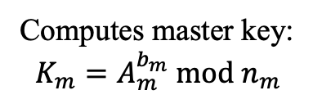

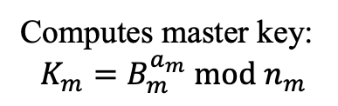
PSP Protocol
Stage 1: Initialization
Owner
Car
$$A_{m}{=g}_{m}^{a_{m}} mod n_{m}$$
Share
$$B_{m}{=g}_{m}^{b_{m}} mod n_{m}$$
$$p\text{riv}ate number:a_{m}$$
$${p\text{riv}ate number:b}_{m}$$
Computes master key:
$$K_{m}=B_{m}^{a_{m}} mod n_{m}$$
Computes master key:
$$K_{m}=A_{m}^{b_{m}} mod n_{m}$$
$g_{m}$ and $n_{m}$ is public
similar to DH key exchange

Slide 7


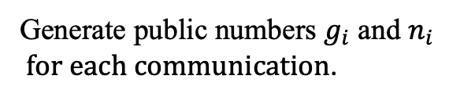
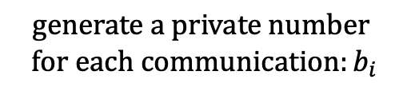
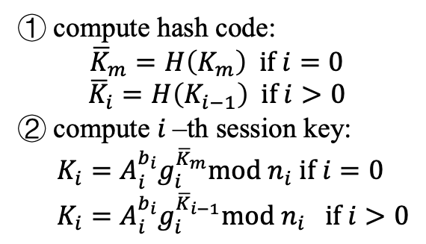
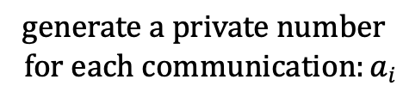
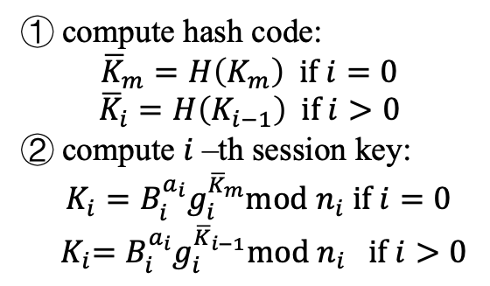
PSP Protocol
Stage 2: Session Key Generation
Owner
Car
$$A_{i}{=g}_{i}^{a_{i}} mod n_{i}$$
Share
$$B_{i}{=g}_{i}^{b_{i}} mod n_{i}$$
$$generate a private number$$
$$for each communication:a_{i}$$
$$generate a private number$$
$$for each communication:b_{i}$$
① compute hash code:
$${\overline{K}}_{m}=H\left(K_{m}\right) if i=0$$
$${\overline{K}}_{i}=H\left(K_{i−1}\right) if i>0$$
② compute $i$–th session key:
${K_{i}=B}_{i}^{a_{i}}g_{i}^{{\overline{K}}_{m}}mod n_{i}$ $if i=0$
$${{ K}_{i}=B}_{i}^{a_{i}}g_{i}^{{\overline{K}}_{i−1}}mod n_{i} if i>0$$
① compute hash code:
$${\overline{K}}_{m}=H\left(K_{m}\right) if i=0$$
$${\overline{K}}_{i}=H\left(K_{i−1}\right) if i>0$$
② compute $i$–th session key:
${K_{i}=A}_{i}^{b_{i}}g_{i}^{{\overline{K}}_{m}}mod n_{i}$ $if i=0$
${K_{i}=A}_{i}^{b_{i}}g_{i}^{{\overline{K}}_{i−1}}mod n_{i} if i>0$
Generate public numbers $g_{i}$ and $n_{i}$
$for each communication$.

Slide 8
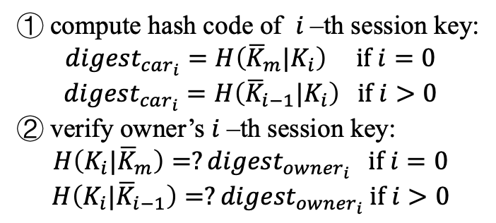
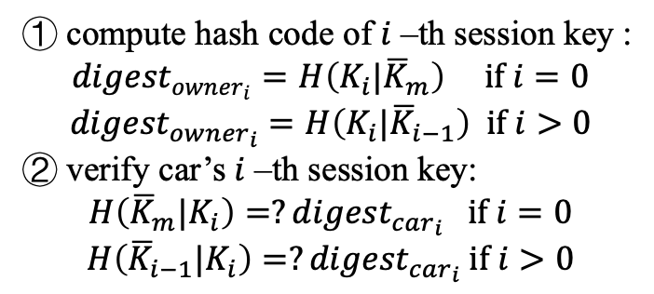
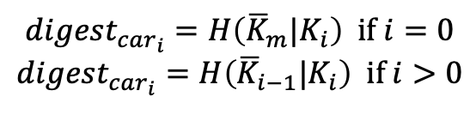
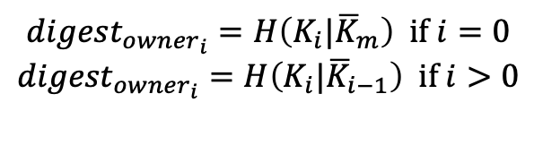
PSP Protocol
Stage 3: Verification
Owner
$${digest}_{{owner}_{i}}=H\left(K_{i}|{\overline{K}}_{m}\right) if i=0$$
$${digest}_{{owner}_{i}}=H\left(K_{i}|{\overline{K}}_{i−1}\right) if i>0$$
Car
Share
$${digest}_{{car}_{i}}=H\left({\overline{K}}_{m}|K_{i}\right) if i=0$$
$${digest}_{{car}_{i}}=H\left({{\overline{K}}_{i−1}|K}_{i}\right) if i>0$$
① compute hash code of $i$–th session key :
$${digest}_{{owner}_{i}}=H\left(K_{i}|{\overline{K}}_{m}\right) if i=0$$
$${digest}_{{owner}_{i}}=H\left(K_{i}|{\overline{K}}_{i−1}\right) if i>0$$
② verify car’s $i$–th session key:
$$H\left({\overline{K}}_{m}|K_{i}\right)=?{digest}_{{car}_{i}} if i=0$$
$$H\left({{\overline{K}}_{i−1}|K}_{i}\right)=?{digest}_{{car}_{i}} if i>0$$
① compute hash code of $i$–th session key:
$${digest}_{{car}_{i}}=H\left({\overline{K}}_{m}|K_{i}\right) if i=0$$
$${digest}_{{car}_{i}}=H\left({{\overline{K}}_{i−1}|K}_{i}\right) if i>0$$
② verify owner’s $i$–th session key:
$$H\left(K_{i}|{\overline{K}}_{m}\right)=?{digest}_{{owner}_{i}} if i=0$$
$$H\left(K_{i}|{\overline{K}}_{i−1}\right)=?{digest}_{{owner}_{i}} if i>0$$

Slide 9
Pros and Cons
Pros
Master key is set when owner bought the car, no one knows it.
The key space of master key is larger than that of session key(256 bits vs 128 bits)
All temporary session data will be flushed if a new session key happens to fail.
Cons
Efficiency. The session key will be generated and verified for each communication.
If master key is compromised, all session keys will be insecure.

